Slide 1
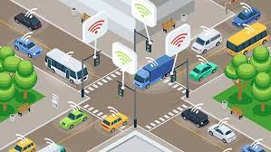
IOT_Phase2
Public Transportation Optimization

Slide 2
Our Solutions:
Real-Time Vehicle Tracking
Unexpected Events
Personalized Travel Information
Real-Time Vehicle Tracking:
one of the biggest complaints of public transit made by passengers is the inability to get real-time information about where the vehicle is or when it will arrive at a particular stop.
Luckily, the Internet of Things technology allows districts to easily track the location of their vehicles.
Districts can install GPS systems on their vehicles that are connected to the internet.
The GPS data is transmitted back to a central command center.
Once the GPS data is received by central command, the information can then be relayed to the passenger’s internet-enabled mobile device or to an electronic sign at transit stops.
Passengers can then know the exact time the vehicle will arrive at a particular stop.

Slide 3
Unexpected Events:
Unforeseen circumstances can sometimes disrupt public transportation such as breakdowns, road closures, or inclement weather.
Internet of Things will enable districts to more easily re-route vehicles, notify passengers, and help them make alternate arrangements.
In the event of an unforeseen circumstance, transit agencies will be able to notify passengers ahead of time by sending out alerts to their mobile phones instead of leaving passengers in the dark.
For example, in the event of a disruption in rail service, transit agencies can take information from ticket scanners that are connected to the internet to determine how many passengers are on the train instead of waiting on a conductor to relay the information.
The transit agency can then determine how many buses to use in a bus bridge to reduce the inconvenience experienced by passengers.

Slide 4
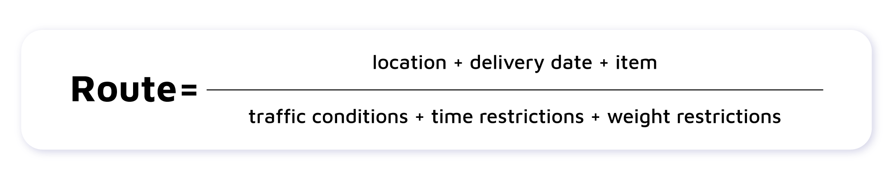
Personalized Travel Information
Personalized information will make passengers of public transport feel as if they are being taken care of. Internet of Things technology will enable transit agencies to easily send out personalized travel information to passengers.
For example, transit agencies can track a particular person’s travel habits and determine which station and/or route that person frequently uses.
In the event of a scheduled station closure or the re-routing of a particular route, the transit agency would be able to notify the person ahead of time.

Slide 5
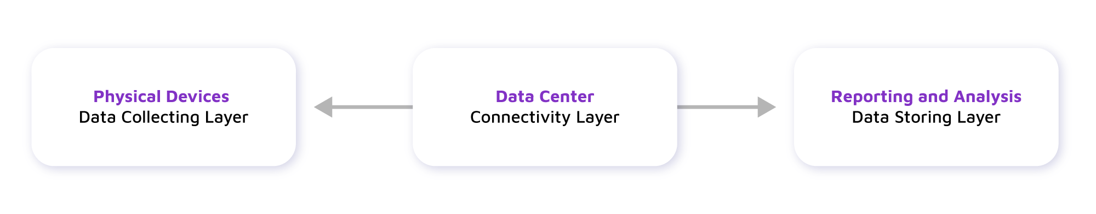
conclusion
The Internet of Things technology will continue to improve the passenger experience for public transportation by offering real-time vehicle tracking, improved responses in the event of an unexpected event, and personalized travel information.
Dependencies:
By using map API’s for finding the route.
For Perfect route of travel using Python ML to Predict.
Weather API’s for route clearance

Slide 6
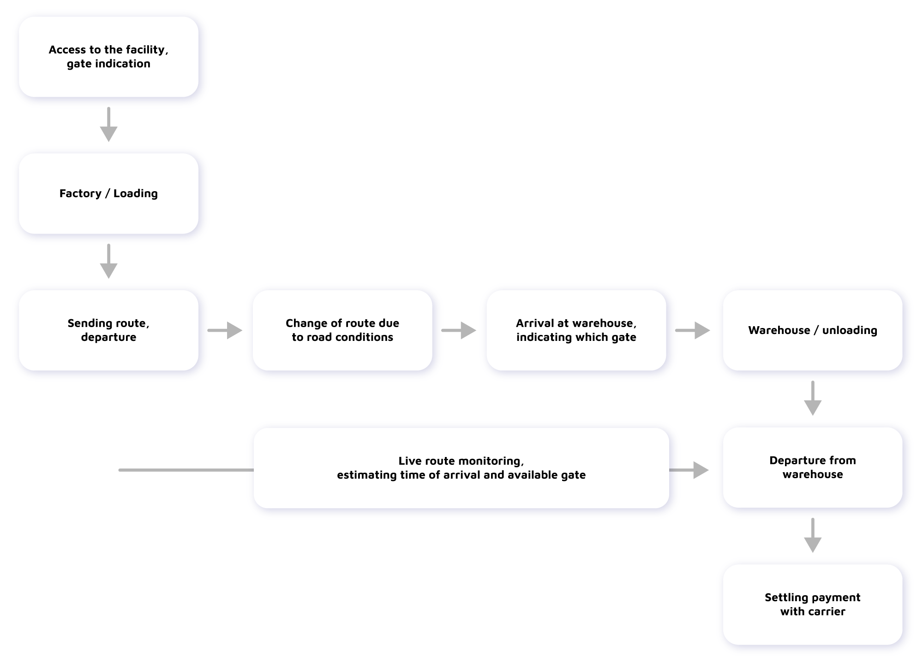
FLOW of work:

Slide 7
TEAM MEMBERS:
SARAN
LISANTH
RAMPRASATH
YOGESH

